Slide 1

CIC Scorecard Refresh for SIL
Presented by:
Data Science
January 2025

Slide 2
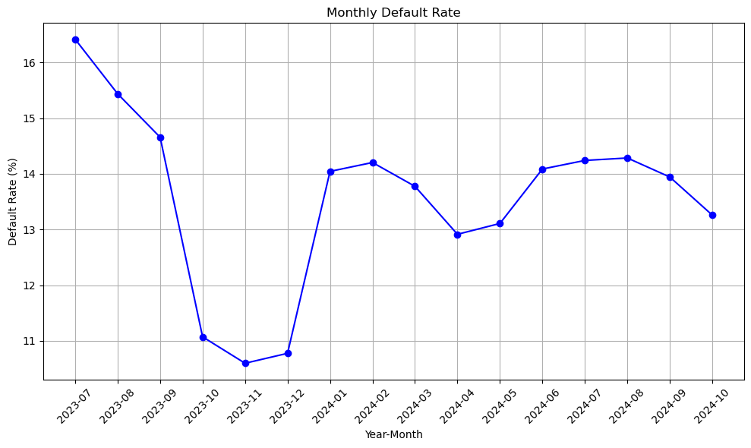
 | Loan Disbursement Date | # SIL Loans |  |  | # Bad (FSPD30) SIL Loans |  |  | FSPD30 rate
 |  | Overall | Mobile | Non Mobile | Overall | Mobile | Non Mobile | Overall | Mobile | Non Mobile
All Data Training – 90%,val – 10% | 01/07/2023 - 30/06/2024 | 70355 | 9662 | 60693 | 7539 | 1696 | 5843 | 0.1071 | 0.1755 | 0.0962
July | 01/07/2024 - 31/07/2024 | 12121 | 4134 | 7987 | 1628 | 781 | 847 | 0.1343 | 0.1889 | 0.1060
Aug | 01/08/2024 - 31/07/2024 | 15075 | 5777 | 9298 | 2071 | 1033 | 1038 | 0.1373 | 0.1788 | 0.111
Sep | 01/09/2024 - 30/09/2024 | 15012 | 5932 | 9080 | 2026 | 1094 | 932 | 0.1349 | 0.1844 | 0.1026
Oct | 01/10/2024 - 25/10/2024 | 10273 | 3877 | 6396 | 1327 | 694 | 633 | 0.1291 | 0.1790 | 0.0989
SIL Loan FSPD30 rate over the months

Slide 3
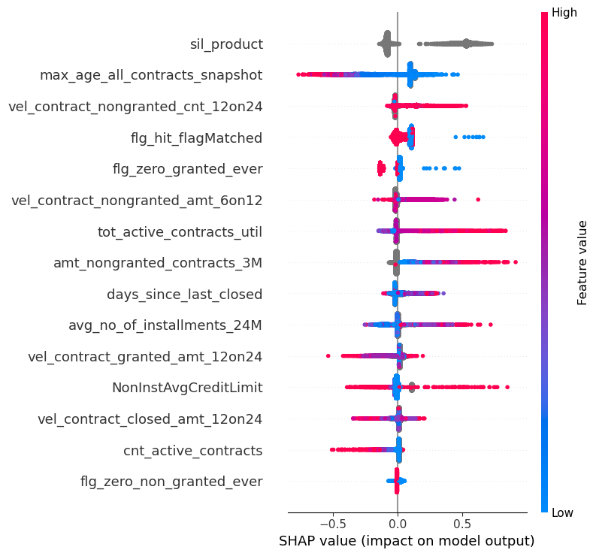
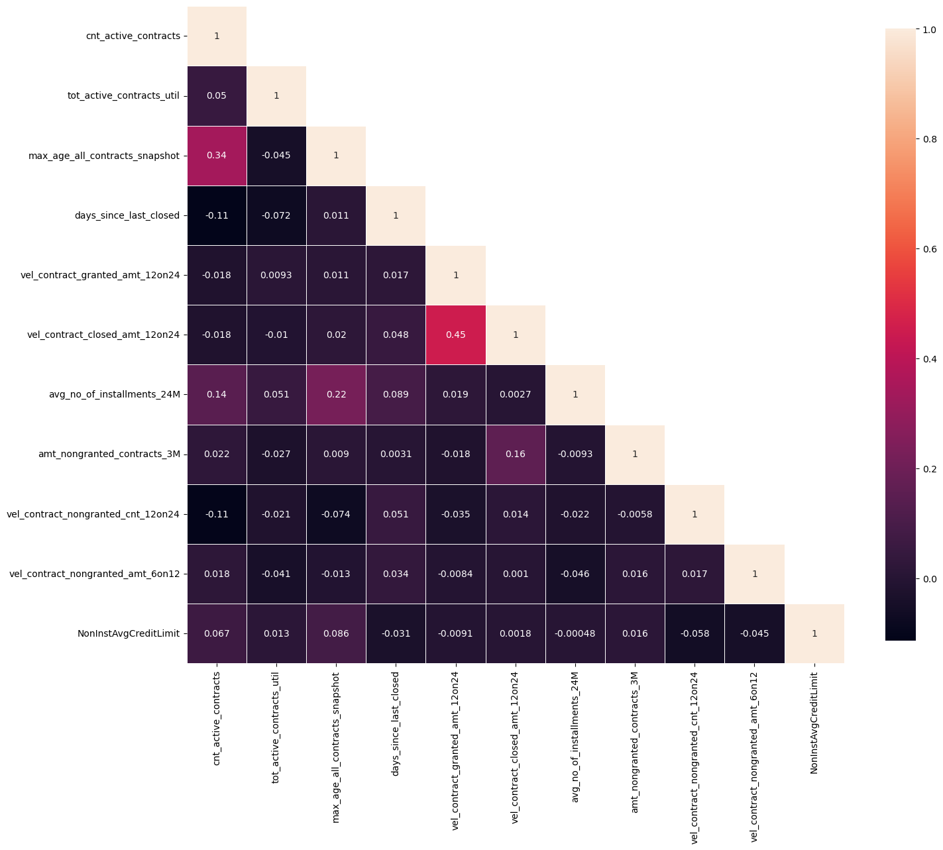
Top 15 Feature Performance

Slide 4
Top 15 Feature Description (1 of 2)
Feature Name | Feature Description
sil_product | Product type of the SIL purchase. Can be one of these 3 values: Mobile/ Appliances/ Mall
max_age_all_contracts_snapshot | For closed contracts age = closed date – start date, for active contracts age = run_date – start date. This feature broadly indicates the max loan tenor of active loans, hence higher tenor means lower risk
vel_contract_nongranted_cnt_12on24 | = count of contracts that granted in last 12 months / count of contracts that were granted in last 24 months. Usually if the velocity of granted loans increases in recent 12 months, it indicates higher risk
flg_hit_flagMatched | 1 means CRIF reported a CIC hit and hence they would charge us, 0 means CRIF reported no CIC hit and hence they won't charge us. Please note CRIF saying hit is not always true hit (we can break down the CRIF reported hits into 3 categories: Hit with at least one granted contract of relevant loan type or at least or not granted loan; Hit but no granted or not granted loan record; Hit with all granted contracts of irrelevant loan type. That's why we created 3 segments out of CRIF hits.
flg_zero_granted_ever | 1 means the customer does not have any granted contract in the CIC data
vel_contract_nongranted_amt_6on12 | = average amount of contracts that were denied in last 6 months / average amount of contracts that were denied in last 12 months. Usually if the velocity of denied loans amount increases in recent 6 months, it indicates higher risk
tot_active_contracts_util | Means the ratio of total outstanding amount of all currently active contracts/ total granted amount of all currently active contracts. This is a snapshot view feature
amt_nongranted_contracts_3M | Total amount from all denied loans in last 3 months
days_since_last_closed | Number of days since the user fully repaid his/her last loan or the last contract was marked as closed in CIC

Slide 5
Top 15 Feature Description (2 of 2)
Feature Name | Feature Description
avg_no_of_instalments_24M | Average number of instalments to be paid for all the contracts granted within last 24 months
vel_contract_granted_amt_12on24 | = average amount of contracts that were granted in last 12 months / average amount of contracts that were granted in last 24 months. Usually if the velocity of granted loans amount increases in recent 12 months, it indicates lower risk
NonInstAvgCreditLimit | Average Credit Limit from all Non-Instalment Loans at the time of querying the CIC. This is a Snapshot view feature. Please note the Non-Instalment loans mean the B2B loans like over-draft and Credit Line. They are NOT individual loans or Retails loans.
vel_contract_closed_amt_12on24 | = average amount of contracts that were closed in last 12 months / average amount of contracts that were closed in last 24 months. Usually if the velocity of closed loans amount increases in recent 12 months, it indicates lower risk
cnt_active_contracts | Total number of Active contracts at the time of querying the CIC data. This is a snapshot view feature
flg_zero_non_granted_ever | 1 means the user was never denied a loan, 0 means the user had at least one denied loan. Please note that here 1 does not always mean lower risk as the user may still be new in the system (thin file user)

Slide 6
Distribution of SIL Loans across various CIC Segments
 | Jul 23 - Jun 24 |  | Test (July) cnt |  |  | OOT (Aug) cnt |  |  | OOT (Sep) cnt |  |  | OOT (Oct) cnt
 | Train cnt | Val cnt | Overall | Mobile | Non Mobile | Overall | Mobile | Non Mobile | Overall | Mobile | Non Mobile | Overall | Mobile | Non Mobile
Model Trained on All the following Segments combined. Tested also on the 3 Segments Combined | 63319 | 7036 | 12121 | 4134 | 7987 | 15075 | 5777 | 9298 | 15012 | 5932 | 9080 | 10273 | 3877 | 6396
Segment 1: flag_matched = 1 AND Either of Granted or Non Granted contracts are available, If Granted Contracts available it will have at least one B2C Loans (Credit Cards, Instalment Loans) |  |  | 8209 | 2938 | 5271 | 11161 | 4407 | 6754 | 10820 | 4410 | 6410 | 7404 | 2864 | 4540
Segment 2: flag_matched = 1 AND Granted Contract of only irrelevant loan types (non-instalment loans, utility payment loans) available, irrespective of Non Granted Loans |  |  | 79 | 31 | 48 | 133 | 56 | 77 | 121 | 61 | 60 | 85 | 36 | 49
Segment 3: flag_matched = 1 AND NONE of Granted or Non Granted contracts are available |  |  | 191 | 46 | 145 | 251 | 83 | 168 | 321 | 107 | 214 | 192 | 65 | 85
Segment 4: flag_matched = 0 |  |  | 3642 | 1119 | 2523 | 3530 | 1231 | 2299 | 3750 | 1354 | 2396 | 2592 | 912 | 1680

Slide 7
 | Jul 23 - Jun 24 |  | Test (July) Gini |  |  | OOT (Aug) Gini |  |  | OOT (Sep) Gini |  |  | OOT (Oct) Gini
7 feature LogReg WOE Model in Production (December) –v1 | Train Gini | Val Gini | Overall | Mobile | Non Mobile | Overall | Mobile | Non Mobile | Overall | Mobile | Non Mobile | Overall | Mobile | Non Mobile
Model Trained on All the following Segments combined. Tested also on the 3 Segments Combined | 0.2555 | 0.2481 | 0.2202 | 0.1457 | 0.2602 | 0.2241 | 0.1681 | 0.2525 | 0.2542 | 0.2007 | 0.2767 | 0.2624 | 0.2294 | 0.2579
Segment 1: flag_matched = 1 AND Either of Granted or Non Granted contracts are available, If Granted Contracts available it will have at least one B2C Loans (Credit Cards, Instalment Loans) |  |  | 0.227 | 0.1452 | 0.2705 | 0.2337 | 0.1745 | 0.2622 | 0.2654 | 0.2092 | 0.2884 | 0.2705 | 0.2355 | 0.2668
Segment 2: flag_matched = 1 AND Granted Contract of only irrelevant loan types (non-instalment loans, utility payment loans) available, irrespective of Non Granted Loans |  |  | -0.0238 | 0.0652 | -0.0718 | -0.1806 | -0.1523 | -0.2881 | 0.0457 | 0.2193 | -0.1328 | -0.0276 | 0.004 | -0.2441
Segment 3: flag_matched = 1 AND NONE of Granted or Non Granted contracts are available |  |  | 0 | 0 | 0 | 0 | 0 | 0 | 0 | 0 | 0 | 0 | 0 | 0
 | Jul 23 - Jun 24 |  | Test (July) Gini |  |  | OOT (Aug) Gini |  |  | OOT (Sep) Gini |  |  | OOT (Oct) Gini
7 feature Refreshed Catboost - v1.1 | Train Gini | Val Gini | Overall | Mobile | Non Mobile | Overall | Mobile | Non Mobile | Overall | Mobile | Non Mobile | Overall | Mobile | Non Mobile
Model Trained on All the following Segments combined. Tested also on the 3 Segments Combined | 0.3247 | 0.2461 | 0.238 | 0.1618 | 0.2775 | 0.2356 | 0.1767 | 0.2619 | 0.2652 | 0.1931 | 0.3072 | 0.2906 | 0.2438 | 0.2961
Segment 1: flag_matched = 1 AND Either of Granted or Non Granted contracts are available, If Granted Contracts available it will have at least one B2C Loans (Credit Cards, Instalment Loans) |  |  | 0.2436 | 0.1635 | 0.2857 | 0.2451 | 0.1849 | 0.272 | 0.2753 | 0.2015 | 0.317 | 0.2984 | 0.2495 | 0.305
Segment 2: flag_matched = 1 AND Granted Contract of only irrelevant loan types (non-instalment loans, utility payment loans) available, irrespective of Non Granted Loans |  |  | 0.0456 | 0.2228 | -0.0312 | -0.2321 | -0.3213 | -0.2505 | 0.0795 | 0.1922 | 0.1922 | -0.0371 | -0.0535 | -0.2403
Segment 3: flag_matched = 1 AND NONE of Granted or Non Granted contracts are available
 | Jul 23 - Jun 24 |  | Test (July) Gini |  |  | OOT (Aug) Gini |  |  | OOT (Sep) Gini |  |  | OOT (Oct) Gini
15 feature Catboost Model -v2 | Train Gini | Val Gini | Overall | Mobile | Non Mobile | Overall | Mobile | Non Mobile | Overall | Mobile | Non Mobile | Overall | Mobile | Non Mobile
Model Trained on All the following Segments combined. Tested also on the 3 Segments Combined | 0.264 | 0.245 | 0.2793 | 0.1677 | 0.2339 | 0.2778 | 0.1839 | 0.2655 | 0.3048 | 0.1969 | 0.2777 | 0.3144 | 0.228 | 0.2701
Segment 1: flag_matched = 1 AND Either of Granted or Non Granted contracts are available, If Granted Contracts available it will have at least one B2C Loans (Credit Cards, Instalment Loans) |  |  | 0.3112 | 0.1959 | 0.2981 | 0.3134 | 0.2065 | 0.314 | 0.3462 | 0.2222 | 0.3393 | 0.3653 | 0.2576 | 0.339
Segment 2: flag_matched = 1 AND Granted Contract of only irrelevant loan types (non-instalment loans, utility payment loans) available, irrespective of Non Granted Loans |  |  | 0.2381 | 0.1196 | 0.2563 | 0.1863 | -0.3273 | 0.3634 | 0.179 | 0.2925 | 0.1895 | 0.2133 | 0.0947 | -0.0775
Segment 3: flag_matched = 1 AND NONE of Granted or Non Granted contracts are available |  |  | 0.1509 | 0 | 0 | 0.0942 | 0 | 0 | 0 | 0 | 0 | 0.0728 | 0 | 0
Segment 4: flag_matched = 0 |  |  | 0.1358 | 0.041 | -0.0634 | 0.1041 | 0.016 | 0.018 | 0.1751 | 0.0602 | 0.0707 | 0.1198 | 0.0156 | 0.0162

Slide 8
Comparison of model performance with and w/o Product Type feat
 | Jul 23 - Jun 24 |  | Test (July) Gini |  |  | OOT (Aug) Gini |  |  | OOT (Sep) Gini |  |  | OOT (Oct) Gini
15 feature Catboost Model -v2 | Train Gini | Val Gini | Overall | Mobile | Non Mobile | Overall | Mobile | Non Mobile | Overall | Mobile | Non Mobile | Overall | Mobile | Non Mobile
Model Trained on All the following Segments combined. Tested also on the 4 Segments Combined | 0.264 | 0.245 | 0.2793 | 0.1677 | 0.2339 | 0.2778 | 0.1839 | 0.2655 | 0.3048 | 0.1969 | 0.2777 | 0.3144 | 0.228 | 0.2701
Segment 1: flag_matched = 1 AND Either of Granted or Non Granted contracts are available, If Granted Contracts available it will have at least one B2C Loans (Credit Cards, Instalment Loans) |  |  | 0.3112 | 0.1959 | 0.2981 | 0.3134 | 0.2065 | 0.314 | 0.3462 | 0.2222 | 0.3393 | 0.3653 | 0.2576 | 0.339
Segment 2: flag_matched = 1 AND Granted Contract of only irrelevant loan types (non-instalment loans, utility payment loans) available, irrespective of Non Granted Loans |  |  | 0.2381 | 0.1196 | 0.2563 | 0.1863 | -0.3273 | 0.3634 | 0.179 | 0.2925 | 0.1895 | 0.2133 | 0.0947 | -0.0775
Segment 3: flag_matched = 1 AND NONE of Granted or Non Granted contracts are available |  |  | 0.1509 | 0 | 0 | 0.0942 | 0 | 0 | 0 | 0 | 0 | 0.0728 | 0 | 0
Segment 4: flag_matched = 0 |  |  | 0.1358 | 0.041 | -0.0634 | 0.1041 | 0.016 | 0.018 | 0.1751 | 0.0602 | 0.0707 | 0.1198 | 0.0156 | 0.0162
SIL Non-Mobile performance is nearly unchanged but overall Gini drops significantly
 | Jul 23 - Jun 24 |  | Test (July) Gini |  |  | OOT (Aug) Gini |  |  | OOT (Sep) Gini |  |  | OOT (Oct) Gini
14 feature Catboost Model –v2 (removed product type feat) | Train Gini | Val Gini | Overall | Mobile | Non Mobile | Overall | Mobile | Non Mobile | Overall | Mobile | Non Mobile | Overall | Mobile | Non Mobile
Model Trained on All the following Segments combined. Tested also on the 4 Segments Combined | 0.2221 | 0.1848 | 0.2198 | 0.1789 | 0.2304 | 0.2332 | 0.1783 | 0.2585 | 0.2504 | 0.1993 | 0.2735 | 0.2689 | 0.236 | 0.2694
Segment 1: flag_matched = 1 AND Either of Granted or Non Granted contracts are available, If Granted Contracts available it will have at least one B2C Loans (Credit Cards, Instalment Loans) |  |  | 0.2689 | 0.2072 | 0.2952 | 0.2739 | 0.2002 | 0.3125 | 0.2998 | 0.2286 | 0.3401 | 0.3233 | 0.2739 | 0.3363
Segment 2: flag_matched = 1 AND Granted Contract of only irrelevant loan types (non-instalment loans, utility payment loans) available, irrespective of Non Granted Loans |  |  | 0.1786 | 0.1087 | 0.2375 | 0.0656 | -0.267 | 0.3462 | 0.1438 | 0.1973 | 0.0588 | -0.024 | -0.037 | -0.124
Segment 3: flag_matched = 1 AND NONE of Granted or Non Granted contracts are available |  |  | 0 | 0 | 0 | 0 | 0 | 0 | 0 | 0 | 0 | 0 | 0 | 0
Segment 4: flag_matched = 0 |  |  | -0.011 | 0.0410 | -0.064 | 0.0143 | 0.0160 | 0.0180 | 0.0666 | 0.0602 | 0.0707 | 0.0122 | 0.0156 | 0.0162

Slide 9
Removed Segment 4 and with and w/o Product Type feat
 | Jul 23 - Jun 24 |  | Test (July) Gini |  |  | OOT (Aug) Gini |  |  | OOT (Sep) Gini |  |  | OOT (Oct) Gini
15 feature Catboost Model -v2 | Train Gini | Val Gini | Overall | Mobile | Non Mobile | Overall | Mobile | Non Mobile | Overall | Mobile | Non Mobile | Overall | Mobile | Non Mobile
Model Trained on All the following Segments combined. Tested also on the 3 Segments Combined | 0.3647 | 0.2977 | 0.3075 | 0.1996 | 0.2880 | 0.3029 | 0.1889 | 0.3020 | 0.3362 | 0.2114 | 0.3318 | 0.3559 | 0.256 | 0.3263
Segment 1: flag_matched = 1 AND Either of Granted or Non Granted contracts are available, If Granted Contracts available it will have at least one B2C Loans (Credit Cards, Instalment Loans) |  |  | 0.3109 | 0.2007 | 0.2945 | 0.3063 | 0.1946 | 0.3036 | 0.3456 | 0.2169 | 0.3396 | 0.3631 | 0.262 | 0.3333
Segment 2: flag_matched = 1 AND Granted Contract of only irrelevant loan types (non-instalment loans, utility payment loans) available, irrespective of Non Granted Loans |  |  | 0.1726 | 0.1957 | 0.0813 | 0.2017 | -0.161 | 0.3484 | 0.1648 | 0.2653 | 0.1329 | 0.1752 | -0.05 | -0.093
Segment 3: flag_matched = 1 AND NONE of Granted or Non Granted contracts are available |  |  | 0.1509 | 0 | 0 | 0.0942 | 0 | 0 | 0.0000 | 0 | 0 | 0.0728 | 0 | 0
SIL Non-Mobile performance is nearly unchanged but overall Gini drops significantly
 | Jul 23 - Jun 24 |  | Test (July) Gini |  |  | OOT (Aug) Gini |  |  | OOT (Sep) Gini |  |  | OOT (Oct) Gini
14 feature Catboost Model –v2 (removed product type feat) | Train Gini | Val Gini | Overall | Mobile | Non Mobile | Overall | Mobile | Non Mobile | Overall | Mobile | Non Mobile | Overall | Mobile | Non Mobile
Model Trained on All the following Segments combined. Tested also on the 3 Segments Combined | 0.3492 | 0.2625 | 0.2644 | 0.2012 | 0.2929 | 0.2672 | 0.1942 | 0.3057 | 0.2918 | 0.2203 | 0.3339 | 0.3125 | 0.2621 | 0.3266
Segment 1: flag_matched = 1 AND Either of Granted or Non Granted contracts are available, If Granted Contracts available it will have at least one B2C Loans (Credit Cards, Instalment Loans) |  |  | 0.2680 | 0.2027 | 0.2969 | 0.2713 | 0.2001 | 0.3072 | 0.2984 | 0.2248 | 0.3406 | 0.3201 | 0.2687 | 0.3339
Segment 2: flag_matched = 1 AND Granted Contract of only irrelevant loan types (non-instalment loans, utility payment loans) available, irrespective of Non Granted Loans |  |  | 0.1706 | 0.2065 | 0.1438 | 0.0644 | -0.309 | 0.3548 | 0.1705 | 0.2211 | 0.0850 | -0.081 | -0.078 | -0.147
Segment 3: flag_matched = 1 AND NONE of Granted or Non Granted contracts are available |  |  | 0 | 0 | 0 | 0 | 0 | 0 | 0 | 0 | 0 | 0 | 0 | 0

Slide 10
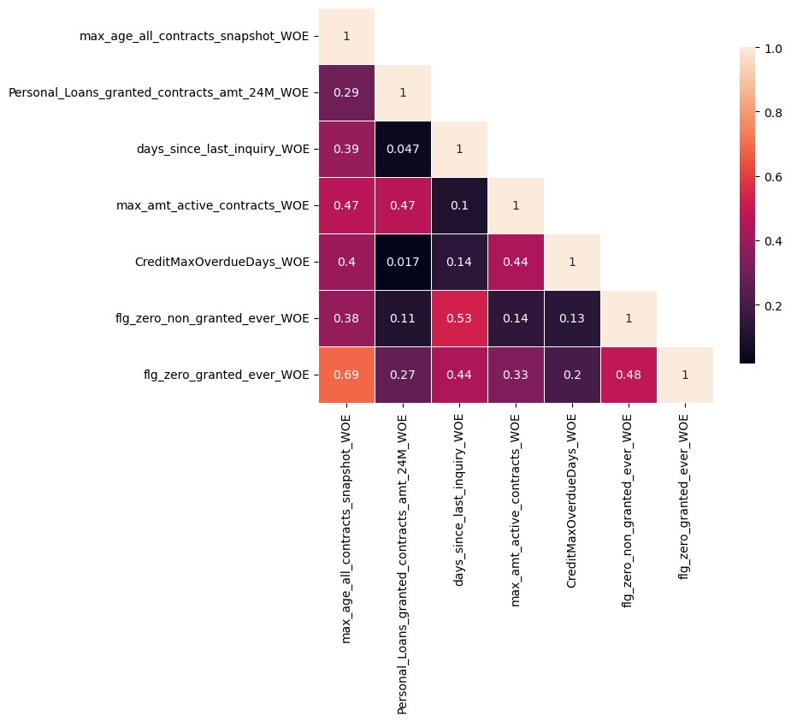
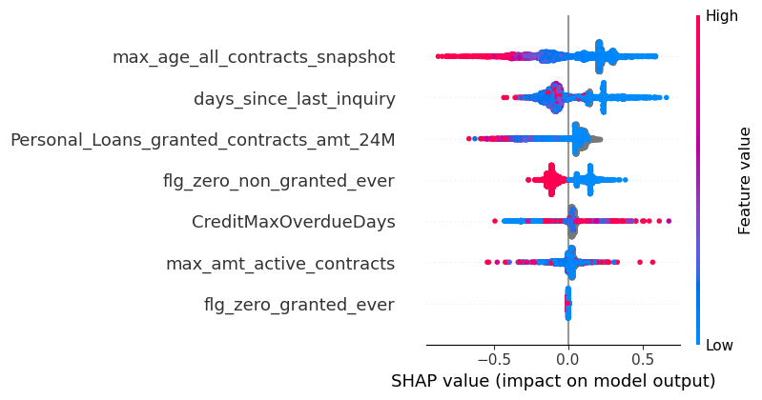
For your Reference: 7 feature LogReg WOE Model in Production (December) –v1 (In production since December 2024)

Slide 11
Appendix

Slide 12
 | Jul 23 - Jun 24 |  | Test (July) Gini |  |  | OOT (Aug) Gini |  |  | OOT (Sep) Gini |  |  | OOT (Oct) Gini
7 feature LogReg WOE Model in Production (December) –v1 | Train Gini | Val Gini | Overall | Mobile | Non Mobile | Overall | Mobile | Non Mobile | Overall | Mobile | Non Mobile | Overall | Mobile | Non Mobile
Model Trained on All the following Segments combined. Tested also on the 3 Segments Combined | 0.2555 | 0.2481 | 0.2202 | 0.1457 | 0.2602 | 0.2241 | 0.1681 | 0.2525 | 0.2542 | 0.2007 | 0.2767 | 0.2624 | 0.2294 | 0.2579
Segment 1: flag_matched = 1 AND Either of Granted or Non Granted contracts are available, If Granted Contracts available it will have at least one B2C Loans (Credit Cards, Instalment Loans) |  |  | 0.227 | 0.1452 | 0.2705 | 0.2337 | 0.1745 | 0.2622 | 0.2654 | 0.2092 | 0.2884 | 0.2705 | 0.2355 | 0.2668
Segment 2: flag_matched = 1 AND Granted Contract of only irrelevant loan types (non-instalment loans, utility payment loans) available, irrespective of Non Granted Loans |  |  | -0.0238 | 0.0652 | -0.0718 | -0.1806 | -0.1523 | -0.2881 | 0.0457 | 0.2193 | -0.1328 | -0.0276 | 0.004 | -0.2441
Segment 3: flag_matched = 1 AND NONE of Granted or Non Granted contracts are available |  |  | 0 | 0 | 0 | 0 | 0 | 0 | 0 | 0 | 0 | 0 | 0 | 0
Old Calculation, for reference purpose only
 | Jul 23 - Jun 24 |  | Test (July) Gini |  |  | OOT (Aug) Gini |  |  | OOT (Sep) Gini |  |  | OOT (Oct) Gini
7 feature Refreshed Catboost - v1.1 | Train Gini | Val Gini | Overall | Mobile | Non Mobile | Overall | Mobile | Non Mobile | Overall | Mobile | Non Mobile | Overall | Mobile | Non Mobile
Model Trained on All the following Segments combined. Tested also on the 3 Segments Combined | 0.3247 | 0.2461 | 0.238 | 0.1618 | 0.2775 | 0.2356 | 0.1767 | 0.2619 | 0.2652 | 0.1931 | 0.3072 | 0.2906 | 0.2438 | 0.2961
Segment 1: flag_matched = 1 AND Either of Granted or Non Granted contracts are available, If Granted Contracts available it will have at least one B2C Loans (Credit Cards, Instalment Loans) |  |  | 0.2436 | 0.1635 | 0.2857 | 0.2451 | 0.1849 | 0.272 | 0.2753 | 0.2015 | 0.317 | 0.2984 | 0.2495 | 0.305
Segment 2: flag_matched = 1 AND Granted Contract of only irrelevant loan types (non-instalment loans, utility payment loans) available, irrespective of Non Granted Loans |  |  | 0.0456 | 0.2228 | -0.0312 | -0.2321 | -0.3213 | -0.2505 | 0.0795 | 0.1922 | 0.1922 | -0.0371 | -0.0535 | -0.2403
Segment 3: flag_matched = 1 AND NONE of Granted or Non Granted contracts are available
 | Jul 23 - Jun 24 |  | Test (July) Gini |  |  | OOT (Aug) Gini |  |  | OOT (Sep) Gini |  |  | OOT (Oct) Gini
15 feature Catboost Model -v2 | Train Gini | Val Gini | Overall | Mobile | Non Mobile | Overall | Mobile | Non Mobile | Overall | Mobile | Non Mobile | Overall | Mobile | Non Mobile
Model Trained on All the following Segments combined. Tested also on the 3 Segments Combined | 0.264 | 0.245 | 0.2793 | 0.1677 | 0.2339 | 0.2778 | 0.1839 | 0.2655 | 0.3048 | 0.1969 | 0.2777 | 0.3144 | 0.228 | 0.2701
Segment 1: flag_matched = 1 AND Either of Granted or Non Granted contracts are available, If Granted Contracts available it will have at least one B2C Loans (Credit Cards, Instalment Loans) |  |  | 0.3112 | 0.1959 | 0.2981 | 0.3134 | 0.2065 | 0.314 | 0.3462 | 0.2222 | 0.3393 | 0.3653 | 0.2576 | 0.339
Segment 2: flag_matched = 1 AND Granted Contract of only irrelevant loan types (non-instalment loans, utility payment loans) available, irrespective of Non Granted Loans |  |  | 0.2381 | 0.1196 | 0.2563 | 0.1863 | -0.3273 | 0.3634 | 0.179 | 0.2925 | 0.1895 | 0.2133 | 0.0947 | -0.0775
Segment 3: flag_matched = 1 AND NONE of Granted or Non Granted contracts are available |  |  | 0.1509 | 0 | 0 | 0.0942 | 0 | 0 | 0 | 0 | 0 | 0.0728 | 0 | 0
Segment 4: flag_matched = 0 |  |  | 0.1358 | 0.041 | -0.0634 | 0.1041 | 0.016 | 0.018 | 0.1751 | 0.0602 | 0.0707 | 0.1198 | 0.0156 | 0.0162

Slide 13
Old Calculation, for reference purpose only
Comparison of model performance with and w/o Product Type feat
 | Jul 23 - Jun 24 |  | Test (July) Gini |  |  | OOT (Aug) Gini |  |  | OOT (Sep) Gini |  |  | OOT (Oct) Gini
15 feature Catboost Model -v2 | Train Gini | Val Gini | Overall | Mobile | Non Mobile | Overall | Mobile | Non Mobile | Overall | Mobile | Non Mobile | Overall | Mobile | Non Mobile
Model Trained on All the following Segments combined. Tested also on the 4 Segments Combined | 0.264 | 0.245 | 0.2793 | 0.1677 | 0.2339 | 0.2778 | 0.1839 | 0.2655 | 0.3048 | 0.1969 | 0.2777 | 0.3144 | 0.228 | 0.2701
Segment 1: flag_matched = 1 AND Either of Granted or Non Granted contracts are available, If Granted Contracts available it will have at least one B2C Loans (Credit Cards, Instalment Loans) |  |  | 0.3112 | 0.1959 | 0.2981 | 0.3134 | 0.2065 | 0.314 | 0.3462 | 0.2222 | 0.3393 | 0.3653 | 0.2576 | 0.339
Segment 2: flag_matched = 1 AND Granted Contract of only irrelevant loan types (non-instalment loans, utility payment loans) available, irrespective of Non Granted Loans |  |  | 0.2381 | 0.1196 | 0.2563 | 0.1863 | -0.3273 | 0.3634 | 0.179 | 0.2925 | 0.1895 | 0.2133 | 0.0947 | -0.0775
Segment 3: flag_matched = 1 AND NONE of Granted or Non Granted contracts are available |  |  | 0.1509 | 0 | 0 | 0.0942 | 0 | 0 | 0 | 0 | 0 | 0.0728 | 0 | 0
Segment 4: flag_matched = 0 |  |  | 0.1358 | 0.041 | -0.0634 | 0.1041 | 0.016 | 0.018 | 0.1751 | 0.0602 | 0.0707 | 0.1198 | 0.0156 | 0.0162
SIL Non-Mobile performance is nearly unchanged but overall Gini drops significantly
 | Jul 23 - Jun 24 |  | Test (July) Gini |  |  | OOT (Aug) Gini |  |  | OOT (Sep) Gini |  |  | OOT (Oct) Gini
14 feature Catboost Model –v2 (removed product type feat) | Train Gini | Val Gini | Overall | Mobile | Non Mobile | Overall | Mobile | Non Mobile | Overall | Mobile | Non Mobile | Overall | Mobile | Non Mobile
Model Trained on All the following Segments combined. Tested also on the 4 Segments Combined | 0.2221 | 0.1848 | 0.2198 | 0.1789 | 0.2304 | 0.2332 | 0.1783 | 0.2585 | 0.2504 | 0.1993 | 0.2735 | 0.2689 | 0.236 | 0.2694
Segment 1: flag_matched = 1 AND Either of Granted or Non Granted contracts are available, If Granted Contracts available it will have at least one B2C Loans (Credit Cards, Instalment Loans) |  |  | 0.2689 | 0.2072 | 0.2952 | 0.2739 | 0.2002 | 0.3125 | 0.2998 | 0.2286 | 0.3401 | 0.3233 | 0.2739 | 0.3363
Segment 2: flag_matched = 1 AND Granted Contract of only irrelevant loan types (non-instalment loans, utility payment loans) available, irrespective of Non Granted Loans |  |  | 0.1786 | 0.1087 | 0.2375 | 0.0656 | -0.267 | 0.3462 | 0.1438 | 0.1973 | 0.0588 | -0.024 | -0.037 | -0.124
Segment 3: flag_matched = 1 AND NONE of Granted or Non Granted contracts are available |  |  | 0 | 0 | 0 | 0 | 0 | 0 | 0 | 0 | 0 | 0 | 0 | 0
Segment 4: flag_matched = 0 |  |  | -0.011 | 0.0410 | -0.064 | 0.0143 | 0.0160 | 0.0180 | 0.0666 | 0.0602 | 0.0707 | 0.0122 | 0.0156 | 0.0162

Slide 14
Old Calculation, for reference purpose only
Removed Segment 4 and with and w/o Product Type feat
 | Jul 23 - Jun 24 |  | Test (July) Gini |  |  | OOT (Aug) Gini |  |  | OOT (Sep) Gini |  |  | OOT (Oct) Gini
15 feature Catboost Model -v2 | Train Gini | Val Gini | Overall | Mobile | Non Mobile | Overall | Mobile | Non Mobile | Overall | Mobile | Non Mobile | Overall | Mobile | Non Mobile
Model Trained on All the following Segments combined. Tested also on the 3 Segments Combined | 0.3647 | 0.2977 | 0.3075 | 0.1996 | 0.2880 | 0.3029 | 0.1889 | 0.3020 | 0.3362 | 0.2114 | 0.3318 | 0.3559 | 0.256 | 0.3263
Segment 1: flag_matched = 1 AND Either of Granted or Non Granted contracts are available, If Granted Contracts available it will have at least one B2C Loans (Credit Cards, Instalment Loans) |  |  | 0.3109 | 0.2007 | 0.2945 | 0.3063 | 0.1946 | 0.3036 | 0.3456 | 0.2169 | 0.3396 | 0.3631 | 0.262 | 0.3333
Segment 2: flag_matched = 1 AND Granted Contract of only irrelevant loan types (non-instalment loans, utility payment loans) available, irrespective of Non Granted Loans |  |  | 0.1726 | 0.1957 | 0.0813 | 0.2017 | -0.161 | 0.3484 | 0.1648 | 0.2653 | 0.1329 | 0.1752 | -0.05 | -0.093
Segment 3: flag_matched = 1 AND NONE of Granted or Non Granted contracts are available |  |  | 0.1509 | 0 | 0 | 0.0942 | 0 | 0 | 0.0000 | 0 | 0 | 0.0728 | 0 | 0
SIL Non-Mobile performance is nearly unchanged but overall Gini drops significantly
 | Jul 23 - Jun 24 |  | Test (July) Gini |  |  | OOT (Aug) Gini |  |  | OOT (Sep) Gini |  |  | OOT (Oct) Gini
14 feature Catboost Model –v2 (removed product type feat) | Train Gini | Val Gini | Overall | Mobile | Non Mobile | Overall | Mobile | Non Mobile | Overall | Mobile | Non Mobile | Overall | Mobile | Non Mobile
Model Trained on All the following Segments combined. Tested also on the 3 Segments Combined | 0.3492 | 0.2625 | 0.2644 | 0.2012 | 0.2929 | 0.2672 | 0.1942 | 0.3057 | 0.2918 | 0.2203 | 0.3339 | 0.3125 | 0.2621 | 0.3266
Segment 1: flag_matched = 1 AND Either of Granted or Non Granted contracts are available, If Granted Contracts available it will have at least one B2C Loans (Credit Cards, Instalment Loans) |  |  | 0.2680 | 0.2027 | 0.2969 | 0.2713 | 0.2001 | 0.3072 | 0.2984 | 0.2248 | 0.3406 | 0.3201 | 0.2687 | 0.3339
Segment 2: flag_matched = 1 AND Granted Contract of only irrelevant loan types (non-instalment loans, utility payment loans) available, irrespective of Non Granted Loans |  |  | 0.1706 | 0.2065 | 0.1438 | 0.0644 | -0.309 | 0.3548 | 0.1705 | 0.2211 | 0.0850 | -0.081 | -0.078 | -0.147
Segment 3: flag_matched = 1 AND NONE of Granted or Non Granted contracts are available |  |  | 0 | 0 | 0 | 0 | 0 | 0 | 0 | 0 | 0 | 0 | 0 | 0

